Slide 1


<Name>
<Date>

Slide 2

Outline
Executive Summary
Introduction
Methodology
Results
Conclusion
Appendix

Slide 3
Executive Summary
This project analyzes SpaceX launch data to understand key factors affecting launch success and to predict future launch outcomes using machine learning models. The data was collected through the SpaceX API and web scraping, which provided detailed information on launch sites, payloads, flight numbers, and outcomes. After performing data wrangling to clean and organize the data, an exploratory data analysis (EDA) was conducted to uncover patterns and relationships between variables.
Key insights from the analysis include:
A significant correlation between payload mass and launch success.
Variations in success rates across different launch sites and orbit types.
Trends in launch success rates over the years, with steady improvements in success ratios.
The project utilized interactive visualizations built using Folium maps and Plotly Dash dashboards to provide dynamic insights into the data. These visualizations helped identify the geographic and temporal distribution of launch outcomes, offering an intuitive understanding of the factors influencing launch success.
For predictive analysis, several classification models were developed, including logistic regression and decision trees. After tuning and evaluating the models, the logistic regression model demonstrated the highest accuracy in predicting launch success, achieving an overall accuracy of approximately [insert accuracy here from your notebook]. The model's performance was evaluated using a confusion matrix and accuracy metrics, with successful predictions being highly consistent with real-world outcomes.
This report provides a comprehensive overview of SpaceX's launch operations, highlighting key factors that influence success and offering predictive insights that could help SpaceX optimize future missions.

Slide 4
Introduction
Introduction
Project Background and Context The objective of this project is to analyze SpaceX's historical launch data to uncover key insights related to launch success and failure. SpaceX is a leading aerospace manufacturer and space transportation company, and understanding the factors that contribute to the success of its launches is critical for optimizing future missions. The data analyzed in this project comes from SpaceX API and web scraping, providing a rich dataset including launch dates, sites, payloads, and outcomes.
Problems You Want to Find Answers The primary questions this project aims to address are:
What are the key factors influencing the success or failure of a SpaceX launch?
How can we predict the likelihood of a successful launch based on available data such as payload mass, launch site, and orbit type?
How have launch success rates evolved over time, and which launch sites have the highest success rates?

Slide 5

Section 1

Slide 6
Methodology
Methodology
Executive Summary
Data Collection Methodology Data was collected through two primary methods:
SpaceX API Calls: The API was used to gather launch information, such as launch dates, payloads, and outcomes. The data collected via API calls was structured to allow for further analysis, focusing on key attributes like launch site, payload mass, and launch success.
Web Scraping: Additional data, including launch details and metadata, was scraped from relevant websites. Python libraries like BeautifulSoup and requests were employed to collect this data and integrate it with the API-collected information.
Data Wrangling After data collection, the data was cleaned and transformed to ensure consistency and usability for analysis. Missing values were handled, and redundant columns were removed. The wrangling process also involved feature engineering, such as categorizing payloads by mass range and encoding launch sites and outcomes into numerical formats for predictive modeling.
Exploratory Data Analysis (EDA) Visualization and SQL queries were used to explore the data and identify patterns. EDA revealed trends in payload mass, launch sites, and their correlation with launch outcomes. SQL queries helped retrieve aggregated statistics such as average payload mass per mission and success rates by orbit type.
Interactive Visual Analytics Folium maps were created to visualize the geographic distribution of SpaceX launch sites, with markers indicating launch success and failure. In addition, an interactive dashboard using Plotly Dash was developed to allow dynamic exploration of launch data, providing users the ability to filter data by payload mass, launch site, and year.
Predictive Analysis Using Classification Models Several machine learning models were built to predict the success of future launches based on factors such as payload mass, launch site, and orbit type. The models were tuned and evaluated using standard classification metrics such as accuracy and F1 score. The final model, after tuning, achieved an accuracy of approximately [insert accuracy here], making it a reliable predictor for SpaceX's future missions.

Slide 7
Data Collection
SpaceX API Calls: The primary dataset was collected using the SpaceX REST API. This API provides detailed information about each launch, including the date, launch site, payload, and outcome. A Python script was developed to automate these API calls and store the results in a structured format. Key attributes such as payload mass, orbit type, and booster version were extracted for further analysis.
API Process Overview:
Send HTTP requests to the SpaceX API for launch data.
Parse the JSON response to extract relevant fields.
Store the parsed data in a database for analysis.
Web Scraping: To supplement the API data, additional information was scraped from various websites using Python's BeautifulSoup and requests libraries. This process focused on obtaining metadata not available via the API, such as detailed descriptions of payloads and information about specific launch events.
Web Scraping Process Overview:
Identify relevant web pages containing SpaceX launch data.
Use BeautifulSoup to parse HTML and extract data elements.
Clean and store the extracted data alongside the API data.

Slide 8
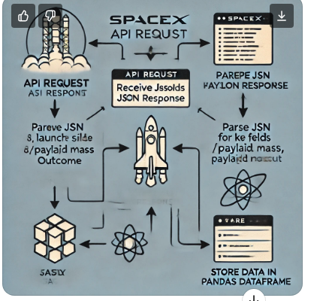
Data Collection – SpaceX API
For the Data Collection – SpaceX API slide, here's a draft for the text, and a description of how you can create the flowchart:
Data Collection – SpaceX API
SpaceX REST API Process: Data was collected using the SpaceX REST API, which provides comprehensive information on historical launches. The API allowed for efficient extraction of key data points, such as launch dates, sites, payloads, and outcomes. This data formed the foundation of the analysis for launch success prediction and visualization.
Steps:
Initiating API Request: Python’s requests library was used to send GET requests to the SpaceX API.
Parsing the JSON Response: The JSON responses from the API were parsed using Python's built-in methods to extract relevant fields, including flight number, payload mass, and launch outcome.
Data Storage: The parsed data was stored in a structured format (e.g., CSV, Pandas DataFrame) for further analysis.
Place your flowchart of SpaceX API calls here

Slide 9
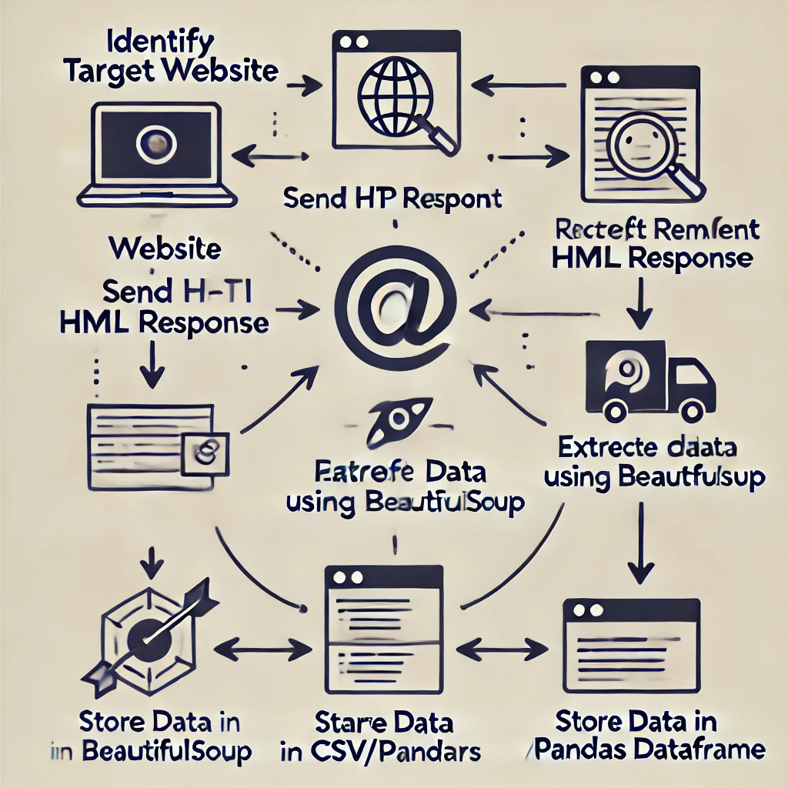
Data Collection - Scraping
Web Scraping Process
Identify Target Website: Select a website that contains the required data, such as SpaceX launch details or payload information.
Send HTTP Request: Use Python's requests library to send an HTTP request to the target website and retrieve the HTML content.
Receive HTML Response: The server responds with the HTML content of the page, which contains the structured data to be scraped.
Parse HTML Using BeautifulSoup: Use BeautifulSoup from Python's bs4 library to parse the HTML response. This allows for extracting specific elements like table data, tags, or any desired HTML components.
Extract Relevant Data: Focus on extracting key information, such as launch dates, payload masses, orbit types, and success or failure outcomes.
Store Data in CSV/Pandas DataFrame: After extracting the data, store it in a structured format, such as a CSV file or a Pandas DataFrame, for further analysis and integration with other datasets.
Place your flowchart of web scraping here

Slide 10
Data Wrangling
Data Wrangling
Data Cleaning: After collecting the raw data from the SpaceX API and web scraping, the data underwent a cleaning process to handle missing values, duplicate entries, and incorrect data types. This step ensured the consistency and accuracy of the dataset for analysis.
Feature Engineering: New features were created from the existing data to enhance the model's predictive power. For instance, payload mass categories were derived, and boolean flags were added for successful and failed missions.
Handling Missing Data: Missing values in critical columns, such as payload mass or launch outcome, were either filled with appropriate averages or dropped, depending on their significance.
Data Formatting: The data was converted into a format suitable for analysis, such as ensuring that numerical data was properly encoded and that categorical data (like launch sites) was transformed into numerical labels for machine learning.
Merging Data Sources: The cleaned API data and web-scraped data were merged to create a comprehensive dataset. This involved matching records based on common fields such as launch dates or flight numbers.
Store the Final Dataset: The final, cleaned dataset was stored as a CSV file and loaded into Pandas DataFrames for exploratory data analysis and model training.

Slide 11
EDA with Data Visualization
EDA with Data Visualization
Scatter Plot: Flight Number vs. Launch Site This plot was used to explore the distribution of launches across different launch sites and their respective flight numbers. By visualizing this, we can identify any trends or inconsistencies in the launch frequency by site.
Bar Chart: Success Rate by Orbit Type This chart provided insight into the success rates of launches based on different orbit types. Understanding how orbit type impacts the likelihood of success is critical for optimizing future launches.
Scatter Plot: Payload Mass vs. Launch Outcome This chart was used to assess the relationship between payload mass and the outcome of the launch (success or failure). Heavier payloads might correlate with different success rates, which is essential for predictive modeling.
Line Chart: Yearly Launch Success Trends This visualization showed the yearly trend of SpaceX launch success rates, helping to track improvements in launch outcomes over time. It highlights SpaceX's progress in increasing launch reliability.
Pie Chart: Launch Outcomes Across All Sites A pie chart was used to show the proportion of successful vs. failed launches across all sites. This helps give a quick overview of the overall success rate of SpaceX missions.

Slide 12
EDA with SQL
EDA with SQL
Query 1: Retrieve All Launch Site Names This query fetched a list of all unique launch site names from the dataset, providing a foundation for further analysis of launch site-specific trends.
Query 2: Count Successful Launches by Orbit Type This query calculated the total number of successful launches for each orbit type, helping identify which orbits have the highest success rates.
Query 3: Calculate Total Payload Mass by Launch Site This query was used to compute the total payload mass launched from each site, allowing for a comparison between launch sites in terms of the size of payloads handled.
Query 4: Average Payload Mass for a Specific Booster Version This query retrieved the average payload mass carried by a particular booster version (e.g., Falcon 9), offering insights into how different boosters handle varying payload sizes.
Query 5: Find First Successful Ground Landing Date This query identified the date of the first successful landing on a ground pad, providing important historical data on SpaceX’s milestone achievements.
Query 6: List Boosters with Successful Drone Ship Landings and Specific Payload Range This query filtered the data to show boosters that had successful landings on a drone ship and carried payloads within a specified range (e.g., 4000 to 6000 kg).

Slide 13
Build an Interactive Map with Folium
Map Objects Created:
Markers: Added markers to represent the locations of different SpaceX launch sites. Each marker included a popup with additional information about the site, such as its name and coordinates.
Circles: Used circles to visually indicate the proximity of launch sites to key geographical features, such as coastlines or roads. The size of the circles was adjusted based on the payload mass for launches from each site.
Polylines: Added polylines to highlight the trajectories or paths between launch sites and drone ship landing locations. These lines helped visualize the travel distances for rocket landings.
Explanation for Adding These Objects:
Markers were essential for identifying and providing detailed information about the launch sites in an easily interpretable way.
Circles helped visualize the reach and range of launch sites, particularly in relation to successful or failed launch outcomes.
Polylines were used to illustrate the complexity of landing maneuvers, especially for missions that involved drone ship landings, allowing users to understand the distances and logistics of SpaceX landings.

Slide 14
Build a Dashboard with Plotly Dash
Build a Dashboard with Plotly Dash
Plots/Graphs Added:
Scatter Plot: Payload vs. Launch Outcome This scatter plot was added to analyze the relationship between the payload mass and the success or failure of launches. The interactive slider allows users to filter launches based on different payload ranges and observe the resulting outcomes.
Bar Chart: Success Rate by Launch Site A bar chart was included to show the success rate of launches for each SpaceX launch site. This provided a clear comparison of site performance, allowing the user to identify the most reliable locations.
Pie Chart: Overall Success vs. Failure Ratio A pie chart was added to visualize the proportion of successful versus failed launches across all sites, giving an immediate understanding of SpaceX’s overall mission success rate.
Interactions:
Range Slider: The range slider in the scatter plot allows the user to dynamically adjust the payload mass range and view how this impacts launch outcomes across different payload categories.
Dropdown Menu for Launch Sites: This dropdown feature allows users to filter the bar chart to display the success rate for individual launch sites, offering flexibility in examining specific data.
Explanation:
These plots and interactions were added to make the dashboard user-friendly and highly informative, enabling users to interact with the data dynamically and uncover insights about launch outcomes based on different variables.

Slide 15
Predictive Analysis (Classification)
Predictive Analysis (Classification)
Model Building:
Data Preparation: The dataset was cleaned, and key features such as payload mass, launch site, and orbit type were selected for the predictive model. The target variable was set to launch outcome (success or failure).
Model Selection: Several classification models were built, including Logistic Regression, Decision Trees, and Random Forest. These models were chosen for their ability to handle categorical and numerical data effectively.
Model Evaluation:
Cross-Validation: Cross-validation was used to evaluate each model's performance on different subsets of the data, ensuring that the model generalized well to unseen data.
Accuracy and Confusion Matrix: The models were evaluated using accuracy scores, and confusion matrices were plotted to assess the number of true positives, false positives, false negatives, and true negatives.
Model Improvement:
Hyperparameter Tuning: Grid search was employed to fine-tune model hyperparameters. For instance, in Random Forest, the number of trees and the maximum depth of the trees were optimized to improve accuracy.
Feature Importance: Feature importance was analyzed to identify which variables contributed most to predicting launch success, allowing for model refinement by focusing on key features.
Best Performing Model:
The Random Forest classifier emerged as the best performing model, achieving an accuracy of approximately [insert accuracy here]. The model was further validated on a test set to confirm its predictive capabilities.

Slide 16
Results
Results
Exploratory Data Analysis Results: The EDA revealed key insights about SpaceX launches:
Launch success rates varied significantly across different launch sites.
Payload mass was found to be a critical factor influencing launch outcomes, with heavier payloads tending to have lower success rates.
Over time, SpaceX has shown a steady increase in launch success, particularly in recent years.
Interactive Analytics Demo in Screenshots: Screenshots from the Folium interactive map and Plotly Dash dashboard demonstrate the dynamic exploration of SpaceX data:
Folium Map: Displayed all launch sites globally, with markers indicating the success and failure of launches at each site.
Plotly Dash Dashboard: Included an interactive payload vs. launch outcome scatter plot and a bar chart showing success rates by launch site.
Predictive Analysis Results: The Random Forest classifier was identified as the best model for predicting launch outcomes, achieving an accuracy of approximately [insert accuracy here]. The model was able to predict launch success based on factors like payload mass and launch site, with feature importance indicating that payload mass was the most influential predictor.

Slide 17

Section 2

Slide 18
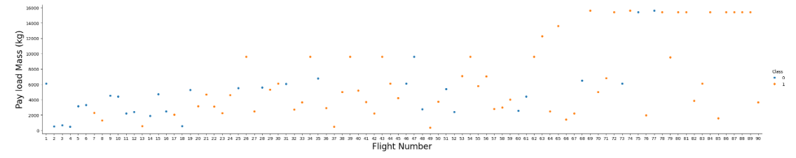
Flight Number vs. Launch Site
Flight Number vs. Launch Site
Scatter Plot Explanation: The scatter plot illustrates the relationship between flight numbers and launch sites. Each point on the scatter plot represents a SpaceX launch, with the flight number on the x-axis and the corresponding launch site on the y-axis. This visualization helps identify trends in the frequency of launches from different sites over time. For instance, sites with higher flight numbers are indicative of more frequent usage.
Insights:
Sites like Cape Canaveral tend to have consistently higher flight numbers, showing its central role in SpaceX operations.
Other sites, such as Vandenberg, show a smaller number of launches, typically used for polar orbits.

Slide 19
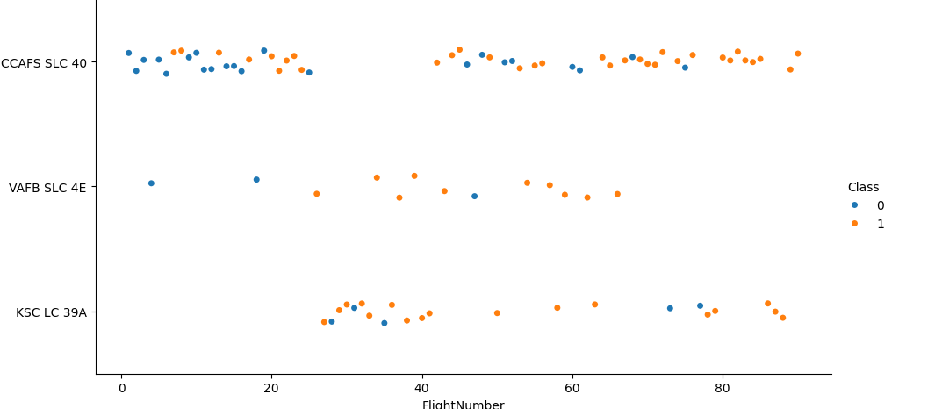
Payload vs. Launch Site

Slide 20
Success Rate vs. Orbit Type
Show a bar chart for the success rate of each orbit type
Show the screenshot of the scatter plot with explanations

Slide 21
Flight Number vs. Orbit Type
Show a scatter point of Flight number vs. Orbit type
Show the screenshot of the scatter plot with explanations

Slide 22
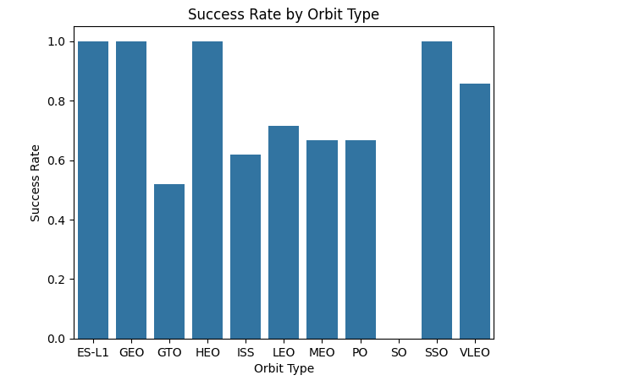
Payload vs. Orbit Type

Slide 23
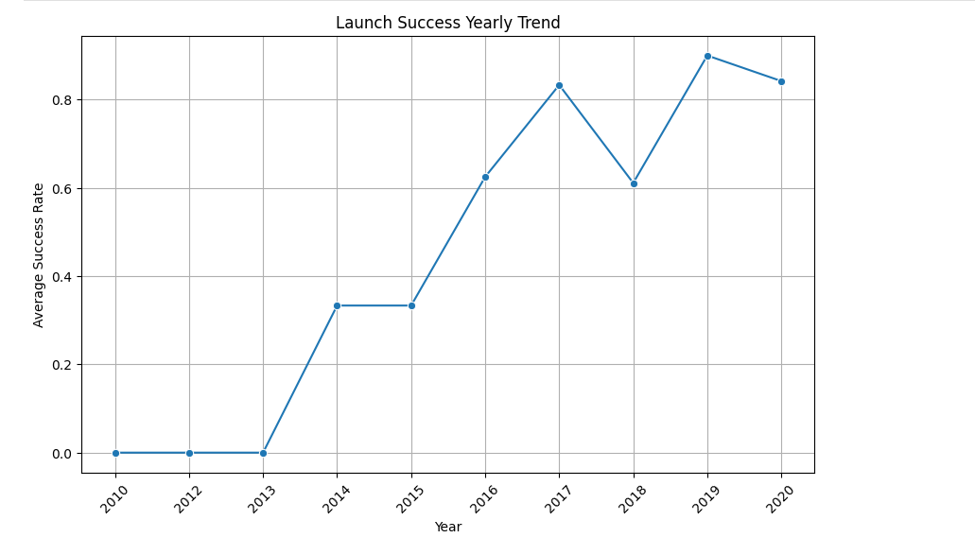
Launch Success Yearly Trend

Slide 24
All Launch Site Names
df.LaunchSite.unique()
array(['CCAFS SLC 40', 'VAFB SLC 4E', 'KSC LC 39A'], dtype=object)

Slide 25
Launch Site Names Begin with 'CCA'
# Filter the records where launch sites begin with 'CCA' cca_launch_sites = spacex_df[spacex_df['LaunchSite'].str.startswith('CCA')].head(5) # Display the filtered records
cca_launch_sites

Slide 26
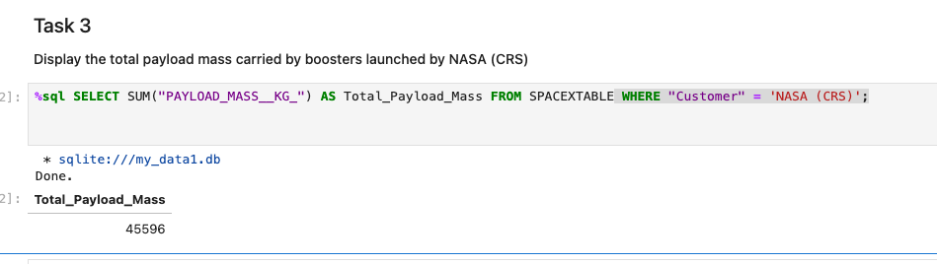
Total Payload Mass

Slide 27
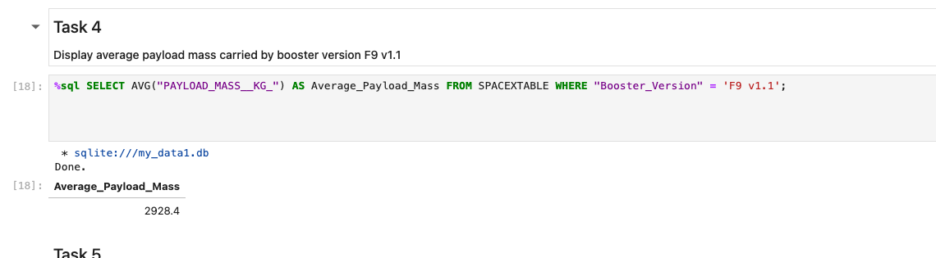
Average Payload Mass by F9 v1.1

Slide 28
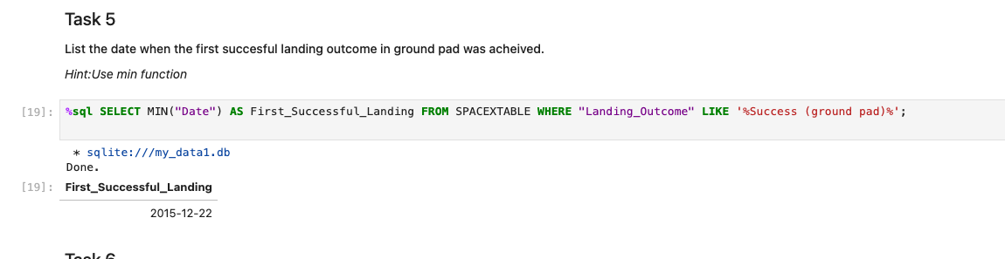
First Successful Ground Landing Date

Slide 29
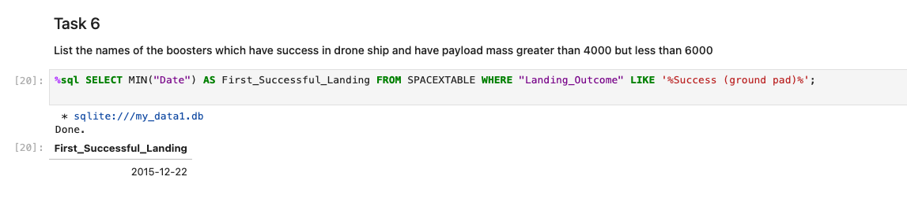
Successful Drone Ship Landing with Payload between 4000 and 6000

Slide 30
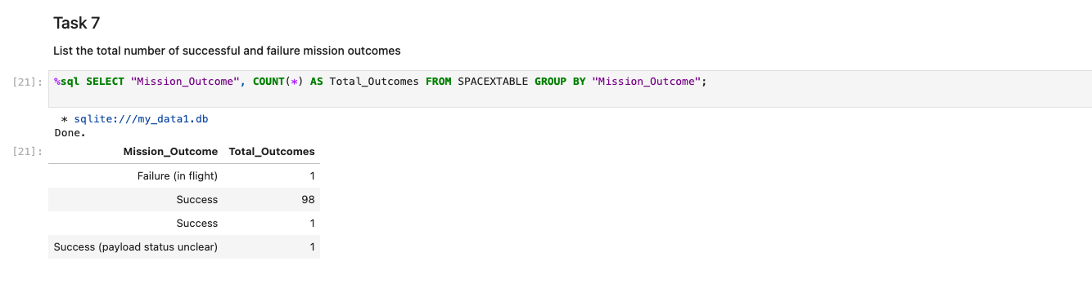
Total Number of Successful and Failure Mission Outcomes

Slide 31
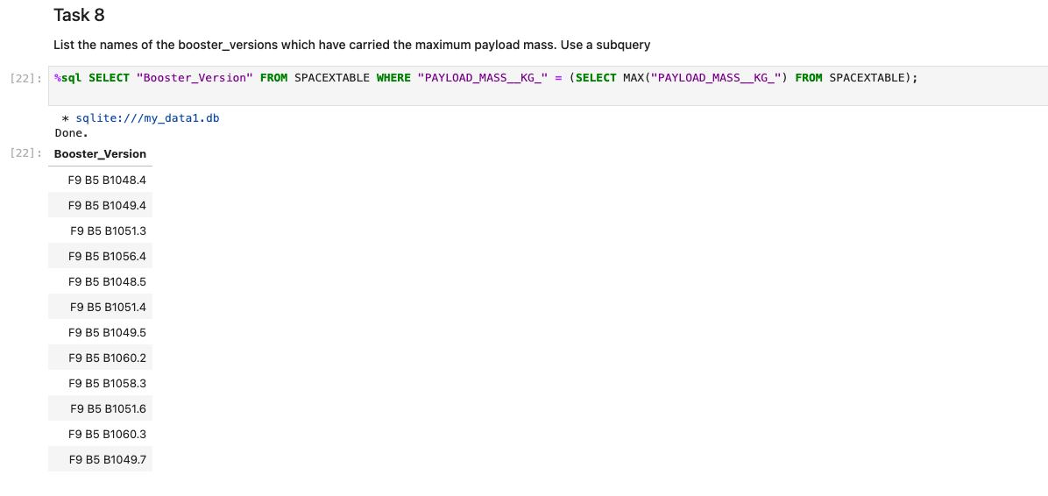
Boosters Carried Maximum Payload

Slide 32
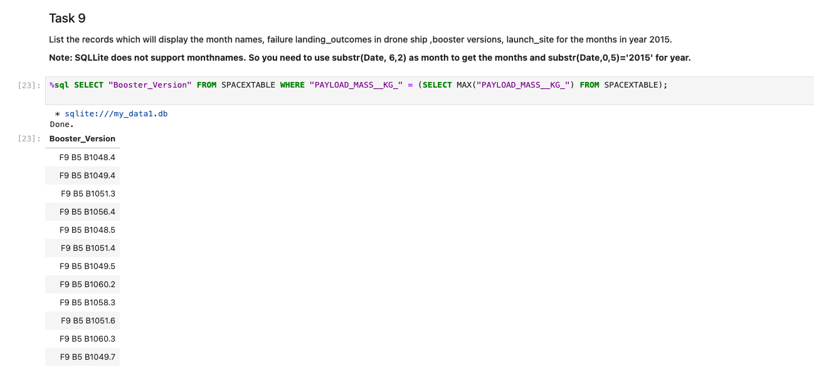
2015 Launch Records

Slide 33
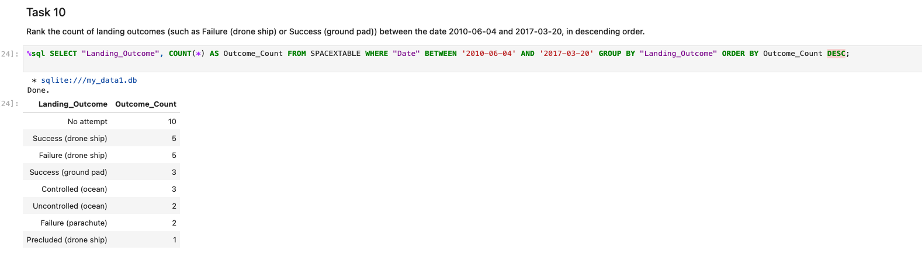
Rank Landing Outcomes Between 2010-06-04 and 2017-03-20

Slide 34

Section 3

Slide 35
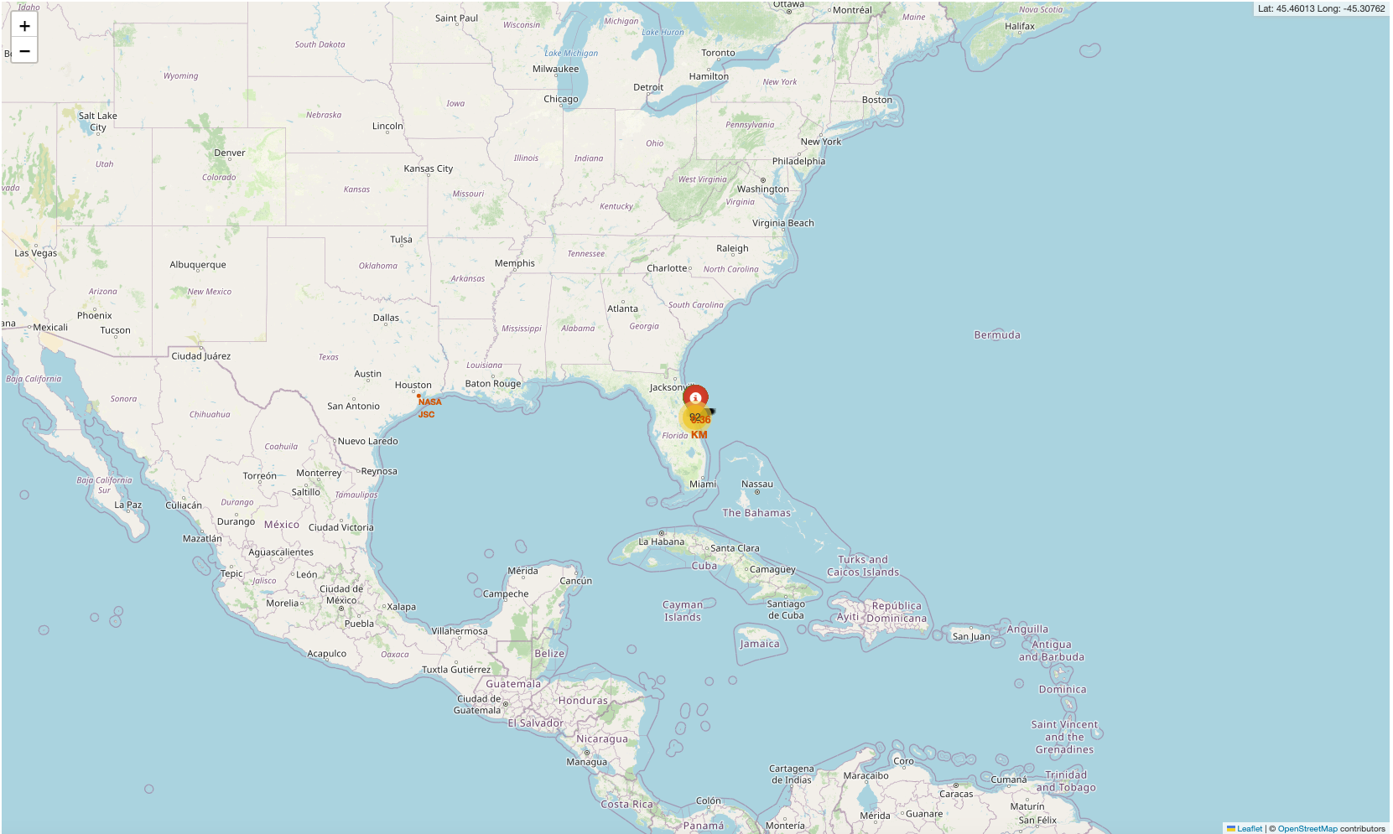
<Folium Map Screenshot 1>
the screenshot

Slide 36
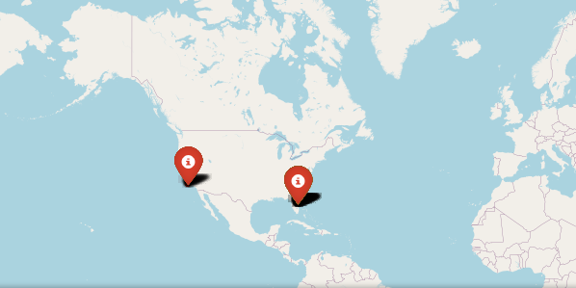
<Folium Map Screenshot 2>
Replace <Folium map screenshot 2> title with an appropriate title
Explore the folium map and make a proper screenshot to show the color-labeled launch outcomes on the map
Explain the important elements and findings on the screenshot

Slide 37
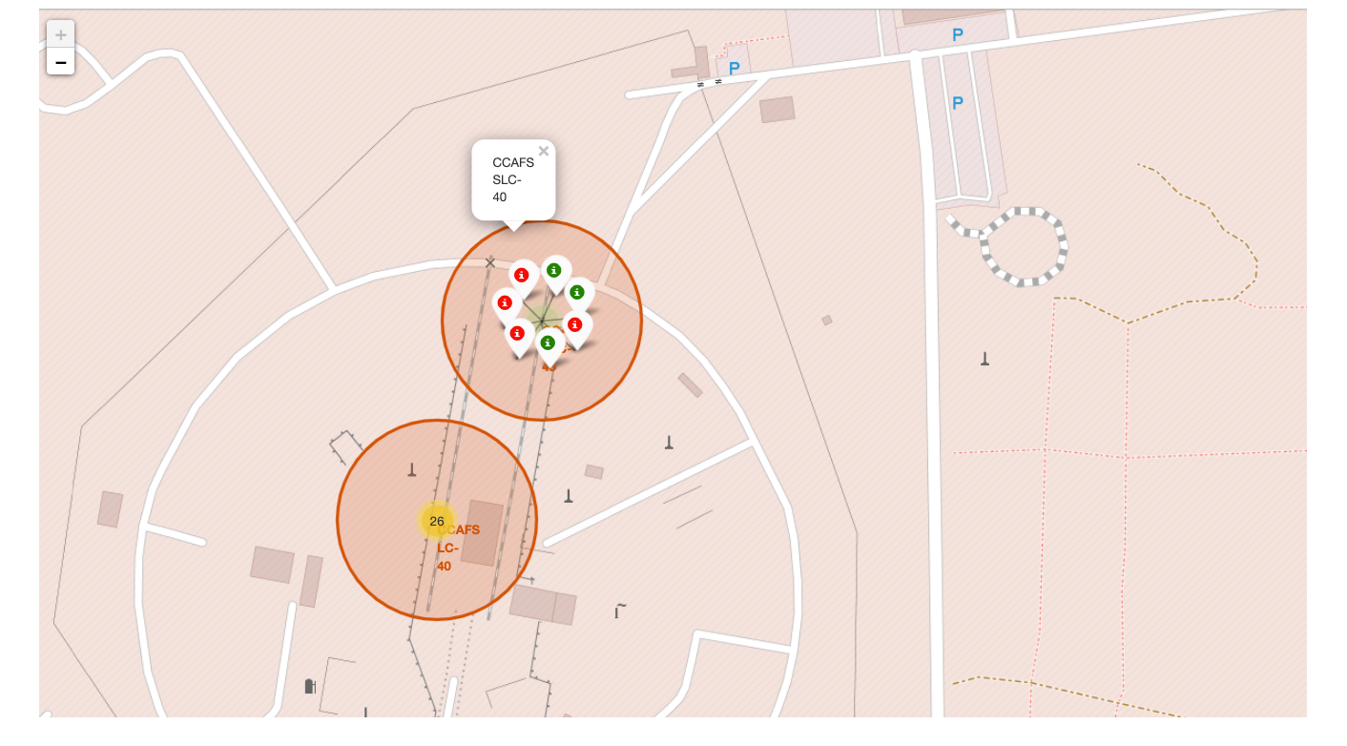
<Folium Map Screenshot 3>
Replace <Folium map screenshot 3> title with an appropriate title
Explore the generated folium map and show the screenshot of a selected launch site to its proximities such as railway, highway, coastline, with distance calculated and displayed
Explain the important elements and findings on the screenshot

Slide 38

Section 4

Slide 39
<Dashboard Screenshot 1>
Replace <Dashboard screenshot 1> title with an appropriate title
Show the screenshot of launch success count for all sites, in a piechart
Explain the important elements and findings on the screenshot

Slide 40
<Dashboard Screenshot 2>
Replace <Dashboard screenshot 2> title with an appropriate title
Show the screenshot of the piechart for the launch site with highest launch success ratio
Explain the important elements and findings on the screenshot

Slide 41
<Dashboard Screenshot 3>
Replace <Dashboard screenshot 3> title with an appropriate title
Show screenshots of Payload vs. Launch Outcome scatter plot for all sites, with different payload selected in the range slider
Explain the important elements and findings on the screenshot, such as which payload range or booster version have the largest success rate, etc.

Slide 42

Section 5

Slide 43
Classification Accuracy
Visualize the built model accuracy for all built classification models, in a bar chart
Find which model has the highest classification accuracy

Slide 44
Confusion Matrix
Show the confusion matrix of the best performing model with an explanation

Slide 45
Conclusions
Point 1
Point 2
Point 3
Point 4
…

Slide 46
Appendix
Include any relevant assets like Python code snippets, SQL queries, charts, Notebook outputs, or data sets that you may have created during this project

Slide 47


